Slide 1


Humic Acid Removal
Investigating how coagulant dosages affect humic acid concentrations in water
More at https://github.com/AguaClara/humic_acid/
Emily Crites | eec67@cornell.edu Rachel Lai | rml267@cornell.edu Abby Kim | sk2459@cornell.edu
Humic Acid Removal | Research | Final Presentation Spring 2022

Slide 2
Table of Contents
Background
Schematic Drawing
Experimental Setup
Previous Work
Current Work
Challenges
Future Tasks
Humic Acid Removal | Research | Final Presentation Spring 2022

Slide 3
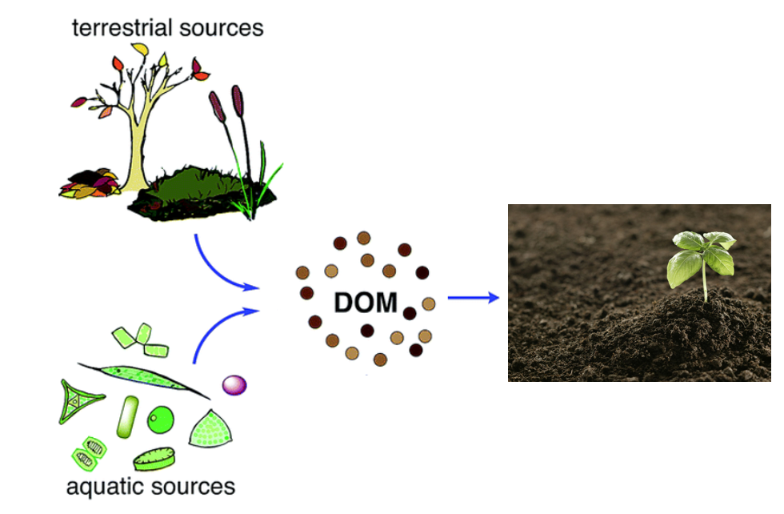
Background
Humic Acid- Dissolved Organic Matter
Creates:
color, taste and odor problems
increased levels of complexed heavy metals and adsorbed organic pollutants
Reacts with chlorine during chlorination - produces harmful byproducts to humans
→ Increased coagulant and disinfectant doses are needed for its removal
Figure 1: Diagram of the formation/ life of dissolved organic material
Humic Acid Removal | Research | Final Presentation Spring 2022
Notes:
Humic acid constitutes a large fraction Dissolved Organic Matter (NOM), which is present in surface and groundwater and results from plant and animal decay. Although it is beneficial to plants because of their stimulation of plant growth and increase of plant disease resistance, it is a deterrent for the drinking water treatment process.
Humic acid has a negative effect on water quality by causing color, taste and odor problems, and increased levels of complex heavy metals and adsorbed organic pollutants. In addition, when humic acid reacts with chlorine, a harmful byproduct chloroform is formed.
Coagulant is a sticky substance that causes the impurities in water to stick together in clumps - called floccs- so that it can be easily removed in the sedimentation tank. Thus, we need to determine a dosage of coagulant that is high enough to remove humic acid, but not enough to prevent flocculation.

Slide 4
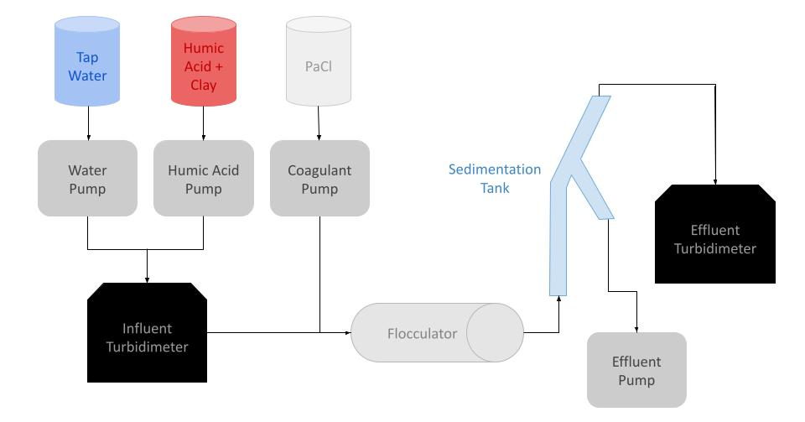
Schematic Drawing
Figure 2: Schematic drawing of the experimental set up for testing varying humic acid and coagulant concentrations
Humic Acid Removal | Research | Final Presentation Spring 2022
Notes:
Brief schematic drawing of process/show general flow of solutions:
Water and humic acid are pumped in and combined before entering the influent turbidimeter. Coagulant is added to the humic acid - water solution and enters the flocculator where flocs form. It then moves into the recirculator where the flocs settle in the sedimentation tank. The wastewater travels out from the recirculator and the clear water rises to the top. Then this goes through the spectrophotometer and effluent turbidimeter to measure the absorbance and turbidity of the effluent water.
explain turbidimeter and how the measurements of influent and effluent will be diff

Slide 5
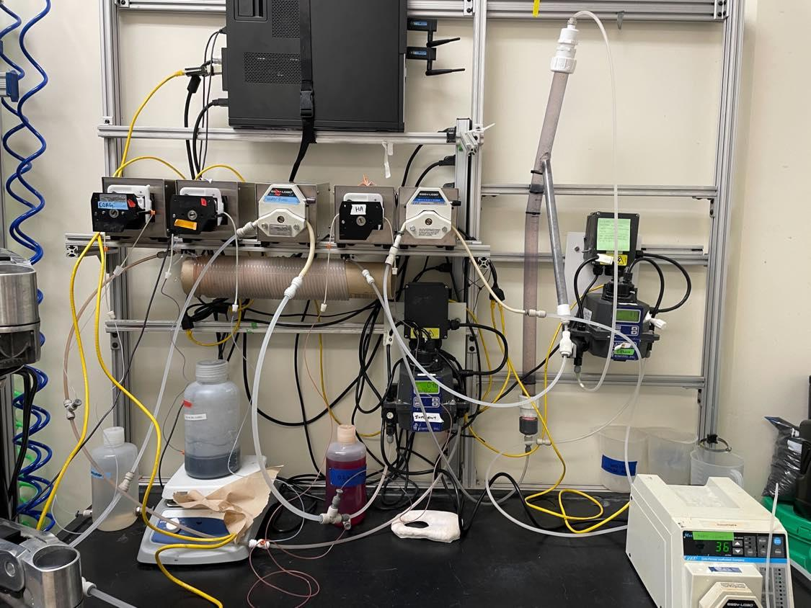
Experimental Design
Water pump
Sedimentation Tank
Coagulant pump
Wastewater out
Humic acid pump
Effluent Turbidimeter
Influent Turbidimeter
Flocculator
Figure 3: Image of lab set-up and experimental design
Humic Acid Removal | Research | Final Presentation Spring 2022
Notes:
Four pumps: one for coagulant, HA, and water. Added two more pumps to ensure that the clean water leaves the system
Water is pumped from the inlet and combined with the HA, then goes into the turbidimeter
Then combines with coagulant stream and goes into the flocculator, then into the sedimentation tank and then the spectrophotometer
Flocs go into the tube settler, then combine with the stream out of the spectrophotometer to go to the wastewater stream out

Slide 6
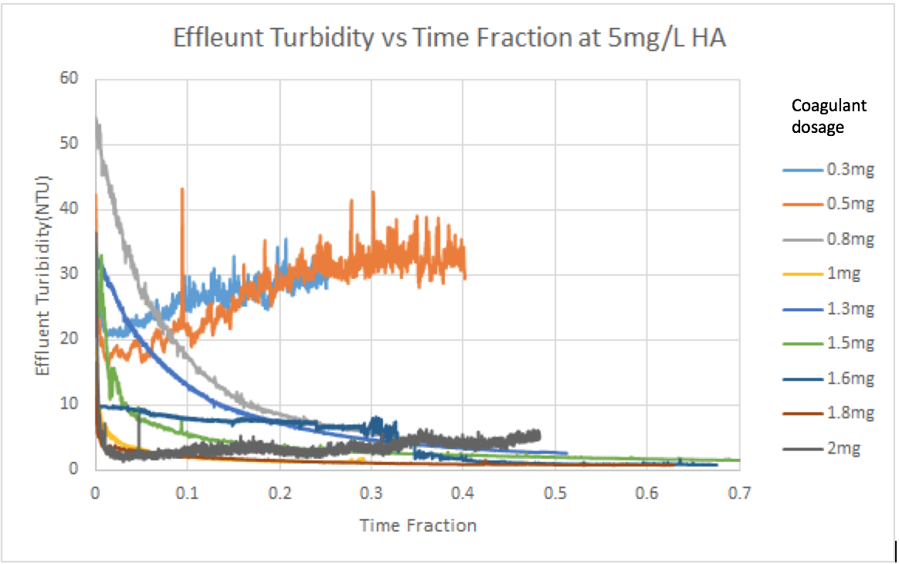
Previous Work
Fall ‘17 and Spring ‘18:
Concentration of Humic Acid (mg/L) | Optimal Coagulant Dosage (mg/L)
5 | 1.6 - 1.8
10 | 1.3
Fall ‘18:
Negative relationship between coagulant dosage and humic acid concentration
Experiments took too long to reach steady state
Figure 4: Absorbance vs. Time Data from Fall ’17/ Spring ‘18 for 5 mg/L of humic acid with various coagulant dosages
Humic Acid Removal | Research | Final Presentation Spring 2022
Notes:
Now I will talking about the previous work done in the past semesters. After conducting several experiments with different concentrations of coagulant, the 2017-2018 team discovered the optimal coagulant dosage to be 1.6-1.8 mg/L for water with 5 mg/L of humic acid concentration and 1.3 mg/L for 10 mg/L of humic acid concentration. These results show a negative relationship between coagulant dosage and humic acid concentration, which we would like to verify since other literatures have suggested a positive correlation between the two. The team also tried to come up with a mathematical model to calculate the optimal coagulant dosage with known concentration of Humic Acid but the problem was that even with a large change in concentration, the resulting optimal dosage change is small.

Slide 7
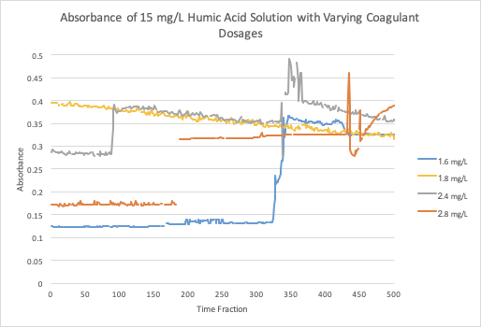
Previous Work
Fall ‘19 and Spring ‘20
Flocs take a long time to form
At higher coagulant dosages around 2-3 mg/L there was very little change of absorbance
Figure 5: Absorbance vs. Time Data from Fall’19 for 15 mg/L at various coagulant dosages
Humic Acid Removal | Research | Final Presentation Spring 2022
Notes:
2 years ago, the focus was on increasing the concentration of humic acid and testing different coagulant dosages at each. The team discovered that at higher coagulant dosages around 2-3 mg/L there was very little change of absorbance recorded which indicates that there’s a limit to how much coagulant can be put in before it becomes ineffective.

Slide 8
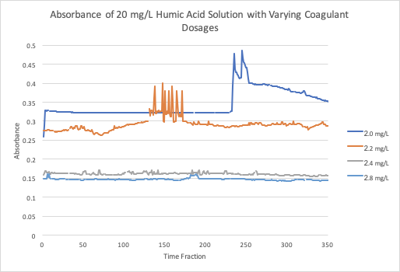
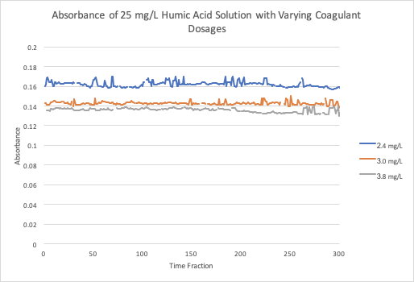
Previous Work
Figure 6: Absorbance vs. Time Data from Fall’19 for 20 mg/L at various coagulant dosages
Figure 7: Absorbance vs. Time Data from Fall’19 for 25 mg/L at various coagulant dosages
Humic Acid Removal | Research | Final Presentation Spring 2022
Notes:
As coagulant doses increase, the absorbance of humic acid decreases. This makes sense because higher concentrations of coagulant can form more flocs in the water and thus decrease the effluent turbidity.
There is a limit to the concentration of coagulant on minimizing the amount of humic acid in water.

Slide 9
Current Work
Obtained new materials
Calibrated turbidimeters
Stock coagulant solutions (72 g/L)
More kaolin clay
Created 2 mg/L coagulant solution
Ran initial testing
Humic Acid Removal | Research | Final Presentation Spring 2022
Notes:
And now, we are going to talk about what we have accomplished this semester. So far, our team has done literature reviews to gain better understandings of natural organic matter, its effects on drinking water, the relationship between humic acid concentration and coagulant concentration, and how different environmental factors affect this relationship. Last semester, most of the experimental design has been set up, and we have familiarized ourselves with ProCoDa. To improve on our experimental design, we are planning to add clay in our experiments to help form floccs in the wastewater. We also added two extra pumps to help wastewater travel out of the system. We noticed that the turbidimeters have not been calibrated for years. The activated carbon subteam has helped calibrated the turbidimeters. Hopefully, now that most of our setup is complete, we can run experiments in the next coming week.

Slide 10
Challenges
Lack of materials
Spectrophotometer
Coagulant
Pipette tips
Malfunctioning of the water line
Uncalibrated tools
turbidimeter
micro pipettes
Humic Acid Removal | Research | Final Presentation Spring 2022
Notes:
Our work was unfortunately limited by the challenges we faced this semester. Throughout the
So far, our team has done literature reviews to gain better understandings of natural organic matter, its effects on drinking water, the relationship between humic acid concentration and coagulant concentration, and how different environmental factors affect this relationship. Last semester, most of the experimental design has been set up, and we have familiarized ourselves with ProCoDa. To improve on our experimental design, we are planning to add clay in our experiments to help form floccs in the wastewater. We also added two extra pumps to help wastewater travel out of the system. We noticed that the turbidimeters have not been calibrated for years. The activated carbon subteam has helped calibrated the turbidimeters. Hopefully, now that most of our setup is complete, we can run experiments in the next coming week.

Slide 11
​​
Coagulant Concentrations
5 mg/L HA | 10 mg/L HA | 15 mg/L HA | 20 mg/L HA | 25 mg/L HA
Coagulant dosages: 0.8 mg/L 1.0 mg/L 1.2 mg/L 1.4 mg/L 1.6 mg/L 1.8 mg/L 2 mg/L | Coagulant dosages: 0.8 mg/L 1.0 mg/L 1.2 mg/L 1.4 mg/L 1.6 mg/L 1.8 mg/L 2 mg/L | Coagulant dosages: 1.6 mg/L 1.8 mg/L 2 mg/L 2.2mg/L 2.4 mg/L 2.8 mg/L | Coagulant dosages: 2 mg/L 2.2 mg/L 2.4 mg/L 2.6 mg/L 2.8 mg/L | Coagulant dosages: 2.4 mg/L 2.6 mg/L 2.8 mg/L 3.0mg/L 3.4 mg/L 3.8 mg/L 4.0 mg/L
Figure 8: Table of coagulant concentrations to use for different concentrations of humic acid
Humic Acid Removal | Research | Final Presentation Spring 2022
Notes:
These are the coagulant concentrations that we determined we needed based on past subteam experimental results.

Slide 12
Future Tasks
Make different concentrations of coagulant solutions
Vary concentrations of humic acid and concentrations of coagulant to prove a positive relationship among both solutions (concentrations suggested above)
Automate Procoda to run for longer periods of time
Humic Acid Removal | Research | Final Presentation Spring 2022
Notes:
Our goals for next semester are to first make different concentrations of the coagulant solutions based on the concentration of humic acid as shown in the previous table and then to validate a positive relationship between humic acid concentrations and coagulant dosage by varying the concentrations of both humic acid and coagulant.
We will also be working towards defining a steady state, which has not yet been determined by the previous teams, so we can get a sense of when the measurements can be taken to be able to get reliable and contributive data that would allow us to interpret the results, find the correlation, and redesign our experiment more easily and accurately. Another goal that we would like to achieve is to design an automated ProCoda code that would allow experiments to run for longer periods of time without us being present in the lab to start and stop the experiments.

Slide 13
Questions
and
Recommendations
Emily Crites | eec67@cornell.edu
Rachel Lai | rml267@cornell.edu
Abby Kim | sk2459@cornell.edu
Humic Acid Removal | Research | Final Presentation Spring 2022

Slide 14
Bibliography
Logan, B. E., Hermanowicz, S. W., & Parker, A. S. (1987). A Fundamental Model for Trickling Filter Process Design. Journal (Water Pollution Control Federation), 59(12), 1029–1042.
Matilaninen, A, Vepsalainen, M & Sillanpaa, M. (2010). Natural Organic Matter Removal by Coagulation during Drinking Water Treatment. Adv Colloid Interface Sci.
Soh, YC, Roddick, F & Van Leeuwen, J. (2008). The Impact of Alum Coagulation on the Character, Biodegradability and Disinfection By-product Formation Potential of Reservoir Natural Organic Matter (NOM) Fractions. Water Sci Technol. 58(6), 1173-9.
Kopfler, F., H. Ringhand, W. Coleman, AND J. Meier. REACTIONS OF CHLORINE IN DRINKING WATER, WITH HUMIC ACIDS AND 'IN VIVO'. U.S. Environmental Protection Agency, Washington, D.C., EPA/600/D-84/196 (NTIS PB85160737).
Du, Y. (2017). Observations and a Geometric Explanation of the Effects of Humic Acid on Flocculation.
Humic Acid Removal | Research | Final Presentation Spring 2022
Notes:
-Carolyn

Slide 15
Appendix
Slides
Humic Acid Removal | Research | Final Presentation Spring 2022
Notes:
This semester, the Humic Acid Removal subteam began work in the lab by familiarizing ourselves with equipment and past work done by previous teams. Moving forward, we are working towards validating the relationship between optimal coagulant dosage and humic acid concentration in order to effectively remove the humic acid from the water in substandard conditions. The team has set up a system in which the effectiveness of the coagulant dosage is evaluated by pumping water, humic acid, and coagulant through an influent turbidimeter, a flocculator, a recirculator, a spectrophotometer, and an effluent turbidimeter.

Slide 16
Background
Humic Acid- Dissolved Organic Matter
Creates:
color, taste and odor problems
increased levels of complexed heavy metals and adsorbed organic pollutants
Reacts with chlorine during chlorination - produces harmful byproducts to humans
→ Increased coagulant and disinfectant doses are needed for its removal
Figure 1: Diagram of the formation/ life of dissolved organic material
Humic Acid Removal | Research | Final Presentation Spring 2022
Notes:
Humic acid constitutes a large fraction Dissolved Organic Matter (NOM), which is present in surface and groundwater and results from plant and animal decay. Although it is beneficial to plants because of their stimulation of plant growth and increase of plant disease resistance, it is a deterrent for the drinking water treatment process.
Humic acid has a negative effect on water quality by causing color, taste and odor problems, and increased levels of complex heavy metals and adsorbed organic pollutants. In addition, when humic acid reacts with chlorine, a harmful byproduct chloroform is formed.
Thus, we need a higher dosage of coagulant to removal humic acid, but not too much to prevent flocculation.

Slide 17
Schematic Drawing
Figure 2: Schematic drawing of the experimental set up for testing varying humic acid and coagulant concentrations
Humic Acid Removal | Research | Final Presentation Spring 2022
Notes:
Brief schematic drawing of process/show general flow of solutions:
Water and humic acid are pumped in and combined before entering the influent turbidimeter. Coagulant is added to the humic acid - water solution and enters the flocculator where flocs form. It then moves into the recirculator where the flocs settle in the sedimentation tank. The wastewater travels out from the recirculator and the clear water rises to the top. Then this goes through the spectrophotometer and effluent turbidimeter to measure the absorbance and turbidity of the effluent water.
explain turbidimeter and how the measurements of influent and effluent will be diff

